Slide 1

Smart Health Monitoring System
Presented by:
Sanskar Patil (B-840)
Samarth Sawant (B-836)
Rishikesh Patil (B-837)
Harsh Singh (B-829)
Under the supervision of:
Prof. Kavita Rathi

Slide 2
Introduction to Smart Health Monitoring System
IoT-based Patient Monitoring System: The Smart Health Monitoring System leverages Internet of Things (IoT) technology to monitor patients continuously, enhancing the quality of care and ensuring timely interventions.
Real-Time Health Tracking: This system provides real-time tracking of patient vitals, allowing healthcare professionals to respond quickly to any changes in a patient's condition.
Automation of ICU Monitoring: By automating the monitoring process, the Smart Health Monitoring System significantly reduces the dependency on manual observation, enabling staff to focus on direct patient care.
Vital Data Collection through Sensors: Advanced sensors collect and transmit vital signs such as heart rate, blood pressure, and oxygen levels, ensuring that healthcare teams have access to the most current data.
Remote Monitoring Capability: The system facilitates remote monitoring, allowing healthcare providers to oversee multiple patients from a centralized location, improving efficiency and response times.
Instant Alerts for Abnormal Values: In case of abnormal values detected by the sensors, the system instantly alerts medical staff, ensuring immediate attention and care for patients in critical conditions.

Slide 3
Literature Survey
no | Year | Authors | Main Principle | Outcome
1 | 2013 | Baig and Gholamhosseini | Provided an overview of smart health monitoring systems, emphasizing design principles and modelling techniques. | Their study outlined various components and functionalities of these systems, highlighting their potential in improving healthcare outcomes.
2 | 2014 | Kim et al | Investigated the coexistence of ZigBee-based Wireless Body Area Networks (WBANs) and WiFi for health telemonitoring systems. | Realized the addressing interference issues and optimizing network performance to facilitate reliable health data transmission.
3 | 2015 | Riazulislam et al. | Conducted a comprehensive survey on the Internet of Things (IoT) for healthcare. | We studied various IoT applications, including remote patient monitoring, wearable devices, and healthcare analytics, underscoring the transformative impact of IoT in the healthcare domain.
4 | 2017 | Al Alkeem et al | Introduced a new secure healthcare system utilizing the Cloud of Things (IoT). | We understood the integration of cloud computing and IoT technologies to ensure secure and efficient health data management.

Slide 4
Problem Statement
Traditional ICUs rely heavily on manual monitoring, leading to delays in detecting critical patient conditions, increased risk of human error, and potential fatalities due to missed or delayed responses.
Healthcare professionals face overwhelming workloads, limiting their ability to monitor multiple patients effectively, while the absence of remote monitoring hinders timely interventions, further jeopardizing patient safety.

Slide 5
Objectives
Real-time Monitoring : Implement continuous tracking of vital parameters such as Heart Rate (HR), Blood Oxygen Saturation (SpO2), and Temperature to ensure immediate response capabilities.
Automated Alerts : Establish a notification system that automatically informs medical staff when vital parameters exceed predefined thresholds, ensuring rapid intervention.
Remote Access : Enable cloud-based access for doctors, allowing healthcare professionals to monitor patients from anywhere, facilitating timely decisions and interventions.
Predictive Analytics : Leverage AI-driven analysis to identify potential health risks early, enhancing proactive healthcare management and improving patient outcomes.
Secure Data Management : Implement robust data management practices to ensure compliance with healthcare regulations, safeguarding patient information and ensuring privacy.

Slide 6
Block Diagram
Data collection from sensors
Data processing by Arduino mega 2560
Wireless Data Transmission via WiFi
Cloud Database Storage
Alert mechanism via SMS and Email
Frontend Data Display
Backend data processing and analysis
.

Slide 7
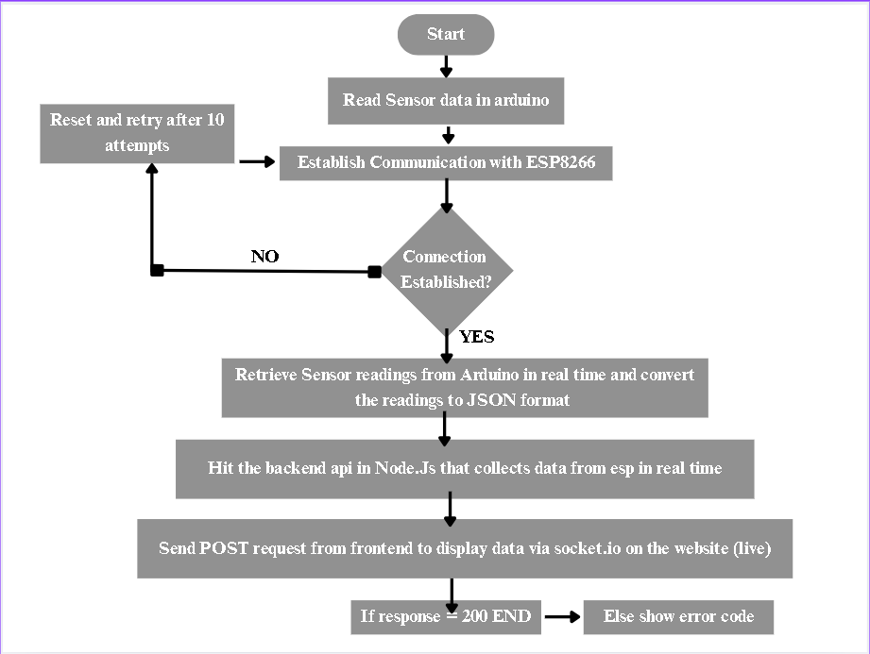
Flow Chart

Slide 8
Methodology
Arduino Mega 2560: Acts as the central processing unit in the system. It simulates various sensors like heart rate, body temperature, and other health metrics. It communicates with the sensors (real or simulated), collects data, and transmits it for processing or visualization.
Electronic Stability Program (ESP) works like the body’s balance system. The steering angle sensor acts like the brain’s intention to move, while the yaw rate and lateral acceleration sensors are similar to the inner ear and sensory nerves that detect body movement and balance. Wheel speed sensors function like muscle receptors, monitoring motion. The ESP control unit, like the brainstem, constantly compares intended movement with actual motion. If it detects a mismatch — like sensing a slip or imbalance — it instantly corrects by applying precise braking to individual wheels and reducing engine power, much like the body reflexively tenses or relaxes muscles to prevent a fall, helping the vehicle regain stability.
16x2 LCD : This display is used to show critical health information to the healthcare provider or patient on-site, such as heart rate, body temperature, and patient status. In the simulation, this is simulated using the frontend, as the LCD is replaced by dynamic displays (e.g., React UI).
DHT 11 : DHT11 sensor functions much like the human body's hypothalamus, which monitors and regulates internal temperature and humidity. The DHT11 has a thermistor, acting like temperature-sensitive nerve endings, to detect heat, and a humidity sensor, similar to receptors in the skin that sense moisture levels. These internal "sensors" send raw signals to the DHT11’s microcontroller, which works like the brain, processing and organizing the data into understandable temperature and humidity readings. Just as the nervous system communicates vital information about the body's environment to maintain balance and comfort, the DHT11 transmits its measurements to a microcontroller or system, helping devices monitor and respond to atmospheric conditions.

Slide 9
ECG Sensor (AD8232):
Our ECG sensor monitors the electrical activity of the heart by measuring the ECG signal. In the simulation, the ECG values are generated to represent the patient’s heart rhythm and condition.
Following are the reasons for using AD8232 ECG sensor in our project:
Compact and Easy to Use: The AD8232 is small and easy to integrate into embedded systems, making it well-suited for projects requiring ECG monitoring. It comes in a compact package, which is ideal for wearable applications, portable health monitoring devices, and other compact devices.
High-Quality Signal Processing: The sensor provides high-quality signal amplification and filtering, removing noise and interference from the raw ECG signal. This is critical for accurate heart rate detection and for monitoring the electrical activity in detail.
Real-Time Monitoring: The sensor allows real-time monitoring of ECG signals, which is essential for detecting abnormal heart patterns (like arrhythmias) and providing timely feedback to healthcare professionals or users.
Support for Customizable Applications: Because the AD8232 is often used with platforms like Arduino, it allows developers to create custom applications, whether it's a heart rate monitor, diagnostic tool, or part of a more comprehensive healthcare system.

Slide 10
SpO2 Sensor (MAX30100 / MAX30102): Our SpO2 sensor monitors blood oxygen saturation (SpO2) and pulse rate by measuring the amount of oxygenated and deoxygenated haemoglobin in the blood through photoplethysmography (PPG). In the simulation, the SpO2 and pulse rate values are generated to reflect the patient's respiratory condition and circulatory health.
Following are the reasons for using the MAX30100 / MAX30102 SpO2 sensor in our project:
Compact and Easy to Use: The MAX30100 and MAX30102 sensors are integrated pulse oximetry and heart-rate monitor modules in a compact package, making them ideal for wearable devices and portable health monitoring systems. Their small footprint simplifies integration into embedded systems.
Accurate Optical Measurement: These sensors use high-sensitivity photodetectors, red and infrared LEDs to accurately measure SpO2 and heart rate, even in low-perfusion conditions. This ensures reliable data collection for critical health monitoring.
Low Power Consumption: Designed for mobile and battery-powered devices, the MAX30100/30102 operate with minimal power, enabling continuous monitoring without significantly draining the power supply — ideal for long-term use in wearable and remote monitoring applications.
Real-Time Monitoring: The sensor provides real-time pulse oximetry and heart rate data, which is crucial for monitoring respiratory and cardiovascular health. This allows early detection of hypoxemia or abnormal pulse rates, improving response times for medical intervention.
Support for Customizable Applications: With support for platforms like Arduino and Raspberry Pi, the MAX30100 / MAX30102 enables developers to build custom healthcare applications — from simple oximeters to advanced wellness tracking systems — tailored to specific user needs.

Slide 11
Web Application
React Front-End: The frontend of our Smart Health Monitor is developed using React, a modern JavaScript library for building responsive and interactive user interfaces. It serves as the primary interface for users and healthcare providers to visualize and interact with real-time health data.
Real-Time Data Visualization: Displays ECG, SpO2, and heart rate data in real-time using dynamic charts and live updates. This allows users to monitor their health status instantly and intuitively.
Responsive and User-Friendly Design: Built with responsiveness in mind, the interface works seamlessly across desktops, tablets, and smartphones, making it accessible anytime, anywhere.
Data Integration: Uses REST APIs or WebSocket connections to fetch live sensor data from the backend or microcontroller, ensuring real-time synchronization between hardware and frontend.
Alerts and Notifications: Provides visual alerts and notifications for abnormal health readings (e.g., low SpO2 or irregular ECG), helping users take timely actions. Health History and Logs: Includes features to display historical health trends using charts, allowing users or doctors to track progress over time.

Slide 12
Node.Js backend: The backend of our Smart Health Monitor is built using Node.js, enabling efficient, real-time data handling and communication between the frontend interface and sensor hardware.
Real-Time Data Handling: Node.js excels at handling asynchronous events, making it ideal for receiving continuous streams of health data (e.g., ECG, SpO2) from sensors via serial communication or network protocols.
API Development (REST & WebSocket): The backend exposes RESTful APIs for fetching health records and uses WebSockets for pushing live sensor data to the React frontend in real time, ensuring a smooth and responsive user experience.
Data Storage & Logging: Integrates with a database (e.g., MongoDB or MySQL) to store historical data, enabling health trend analysis and future reference. Data is timestamped and categorized for each patient/user.
Alert Logic & Threshold Monitoring: Implements backend logic to monitor incoming data against predefined thresholds. If abnormal values are detected (e.g., low oxygen levels, irregular heartbeat), it triggers alerts to notify the user or provider.
Secure & Scalable Architecture: Built using Express.js for routing and middleware, the backend ensures secure API endpoints and supports easy scaling as the system grows in functionality or user base.

Slide 13
Real-Time Data Streaming: Socket.IO: To enable live updates of sensor data (ECG, SpO2, temperature, and humidity), our system uses Socket.IO, a real-time, event-based communication library built on WebSockets.
Socket.IO enables low-latency, bidirectional communication between the Node.js backend and the React frontend, allowing sensor data to be pushed to the user interface the moment it's received.
Efficient ECG Streaming: ECG data is often high-frequency and continuous. Socket.IO efficiently transmits this data in chunks, ensuring the ECG graph updates in real time without noticeable delay or performance loss.
Live Environmental Monitoring: Temperature and humidity readings are sent at regular intervals, keeping the display current and enabling immediate awareness of any environmental changes.
Multi-Sensor Support: Different sensor data streams (ECG, SpO2, temperature, humidity) are managed through separate socket events, ensuring clean, organized communication channels and modular frontend updates.
Improved User Experience: Live updates remove the need for page refreshes or polling mechanisms, resulting in a smooth, responsive interface — especially critical for real-time health monitoring.

Slide 14
Redis & Docker: Fast In-Memory Caching with Scalable Deployment: To enhance performance and scalability, we use Redis as an in-memory caching solution, containerized using Docker for easy deployment and isolation.
High-Speed Data Access: Redis stores frequently accessed data (like recent ECG, SpO2, temperature, and humidity readings) in memory, allowing near-instant retrieval for real-time frontend updates.
Reduces Backend Load: By caching recent sensor data, Redis minimizes the need to repeatedly query the main database or wait for slower sensor I/O improving backend responsiveness.
Isolation & Security: Containerization ensures Redis operates independently from other services, reducing interference and improving security.
Scalable & Reproducible: Docker makes it simple to scale Redis or spin up additional instances for load balancing, development, or testing with consistent environments.

Slide 15
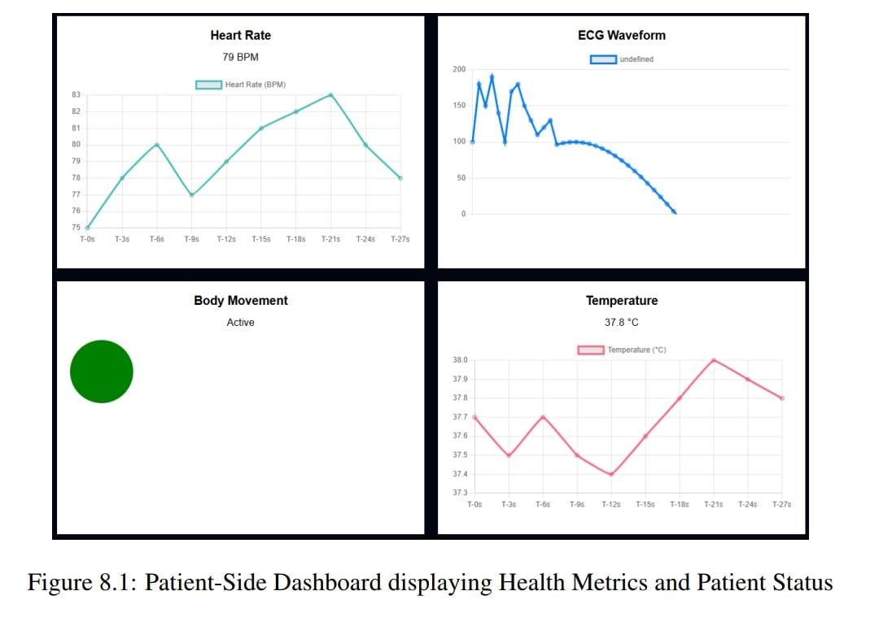
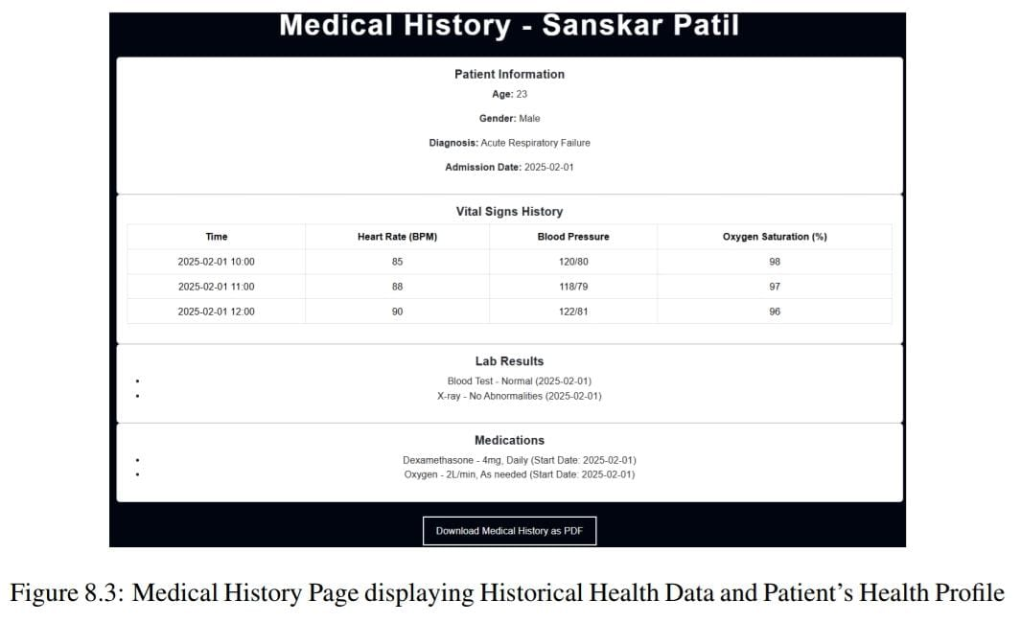
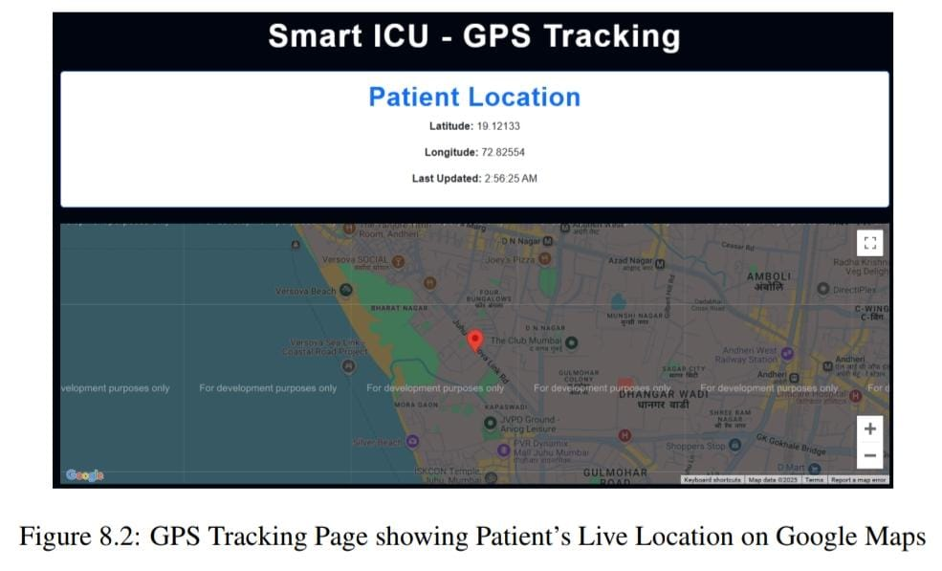
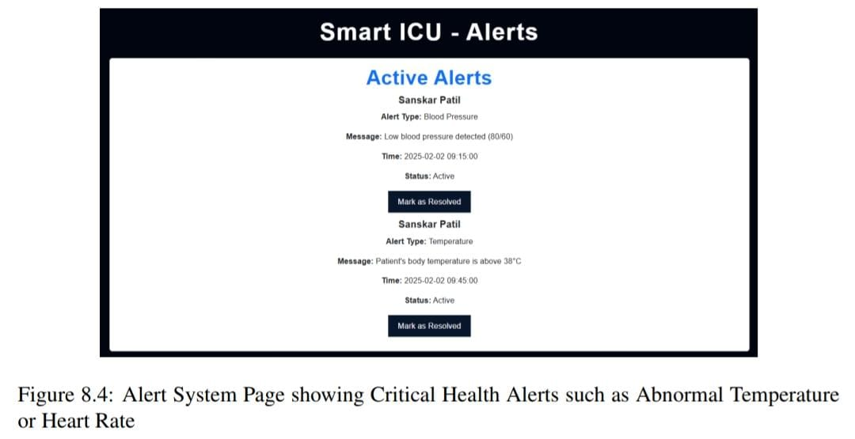
Result

Slide 16
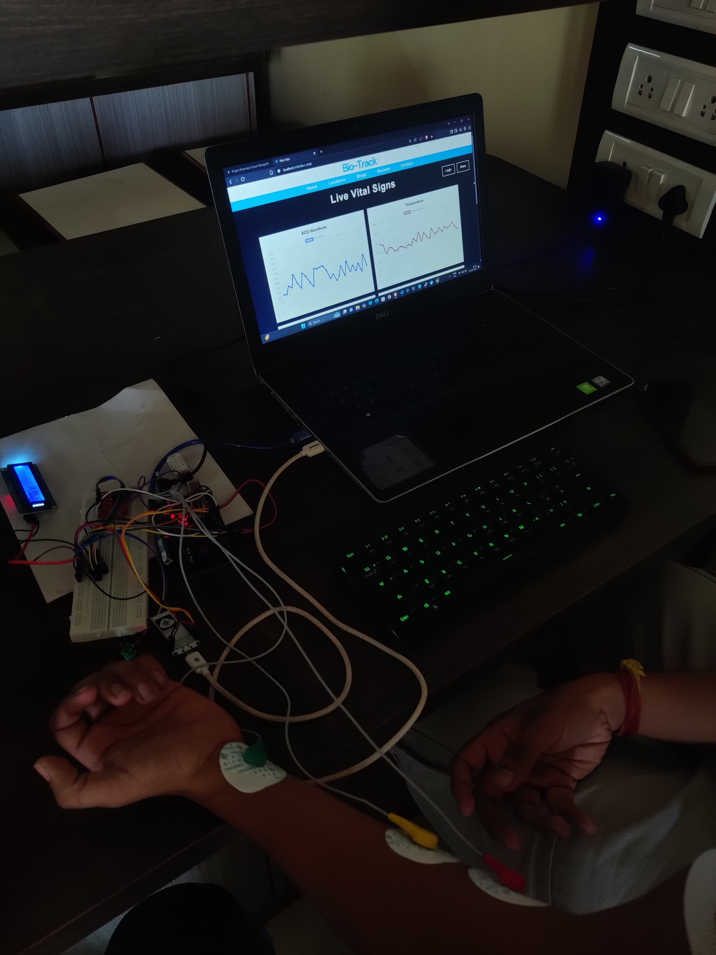

Slide 17
Future Scope
Advanced Alert System with AI Integration: The current alert system is based on threshold values for different health parameters. Future enhancements can incorporate Artificial Intelligence (AI) and Machine Learning (ML) to :
Detect patterns in a patient’s health data over time.
Predict potential health risks based on historical trends
Reduce false alarms by distinguishing between critical conditions and temporary fluctuations.
Cloud-Based Data Storage and Remote Access: At present, patient data is managed on the frontend. A cloud-based infrastructure can be implemented to:
Store real-time patient data securely on cloud servers.
Enable healthcare providers to access patient history from any location.
Allow for data analysis and trend visualization over extended periods.
Mobile App Integration : To improve accessibility, a mobile application can be developed alongside the web interface. This would allow:
Patients and caregivers to receive real-time alerts and notifications.
Doctors to monitor patient vitals remotely from their smartphones.
Location tracking via GPS to be more seamless and efficient.

Slide 18
Challenges and solutions
Challenge: API Integration with Google Maps : Integrating the application with Google Maps API posed significant challenges in terms of functionality and performance. Ensuring seamless communication between our application and Google Maps was crucial for user experience.
Solution: React-Google-Maps API : To address the integration challenges, we utilized the React-Google-Maps API, which allowed for dynamic updates and enhanced interaction with map features. This solution significantly improved the responsiveness of map-related functionalities.
Challenge: Simulating Real-time Sensor Data : Simulating real-time sensor data for testing purposes was another critical challenge. Accurate data representation was necessary to evaluate the system's performance under different scenarios.
Solution: JavaScript Randomization for Test Cases : To effectively simulate real-time sensor data, we implemented JavaScript randomization techniques. This approach allowed us to create varied test cases, ensuring robust testing of the application’s functionality.
Challenge: Ensuring Real-time Notifications : Real-time notifications were essential for user engagement and timely updates. However, maintaining the reliability of these notifications under fluctuating conditions proved to be challenging.
Solution: Backend Alert Triggers via Threshold Limits : To ensure timely notifications, we established backend alert triggers that activated based on predefined threshold limits. This solution allowed for immediate alerting when critical conditions were met, enhancing user response times.

Slide 19
Conclusion
The Smart ICU system uses IoT technology to enable continuous, real-time monitoring of vital signs such as ECG, SpO2, temperature, and humidity. It is designed to automatically detect anomalies in patient data and send instant alerts to healthcare professionals, allowing for rapid and remote intervention. This enhances patient safety by ensuring that critical changes in condition are addressed without delay.
By automating routine monitoring tasks, the system significantly reduces the administrative burden on medical staff, allowing them to dedicate more time to direct patient care. The integration of Redis for in-memory caching ensures that frequently accessed data is available instantly, improving response time and reducing the load on the main database.
All vital sign data is stored in a secure online database, ensuring that patient information is centralized, persistent, and remotely accessible for authorized personnel. This supports long-term health tracking and simplifies data retrieval for analysis and reporting.
The system’s use of live data streaming through Socket.IO ensures that sensor data is delivered and visualized on the frontend in real time. This real-time capability is crucial in an ICU setting, where even a few seconds of delay can impact patient outcomes. Overall, the Smart ICU system provides a scalable, efficient, and intelligent solution for modern healthcare environments.

Slide 20
References
E. Al Alkeem et al., ”New secure healthcare system using cloud of things,” Springer Science+Business Media New York, 2017. Available at: https://www.researchgate.net/publication/316749947_New_ secure_healthcare_system_using_cloud_of_things
. Y. Kim, S. Lee, and S. Lee, ”Coexistence of ZigBee-based WBAN and WiFi for Health Telemonitoring Systems,” IEEE Journal of Biomedical and Health Informatics, DOI: 10.1109/JBHI.2014.2387867.
M. M. Baig and H. Gholamhosseini, ”Smart Health Monitoring Systems: An Overview of Design and Modelling,” Springer Science+Business Media New York, 2013.
S. M. Riazulislam et al., ”The Internet of Things for Health Care: A Comprehensive Survey,” IEEE Transactions, DOI: 10.1109/TDSC.2015.2406699. Available at: https://www.semanticscholar.org/paper/ The-Internet-of-Things-for-Health-Care%3AA-Survey-Islam-Kwak/ cddb22908f28a1636cbbdeb3a4f0e00f9cef05a9
A. Mdhaffar et al., ”IoT-based Health Monitoring via LoRaWAN,” IEEE EUROCON 2017. Available at: https://www.researchgate.net/publication/319169748_ IoT-based health monitoring via LoRaWAN
M. M. Masud et al., ”Resource-Aware Mobile-Based Health Monitoring,” 2015 IEEE.

